Slide 1
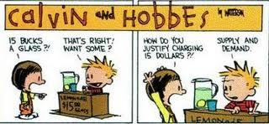
Equilibrium in the Market

Slide 2
What is Equilibrium?
The place where the buyers and sellers agree how much they demand and how much will be produced.

Slide 3
II. Role of Competition:
Competition among sellers results in lower costs and prices, high product quality, and better customer service.

Slide 4
(II) Role of Competition
Competition among buyers increases prices and directs goods and services to those people who are willing and able to pay for them most.

Slide 5
III. The Result of Competition:
As a result, competition among buyers and sellers creates EQUILIBRIUM price naturally (without government intervention).

Slide 6
IV. Equilibrium (Characteristics):
The condition of being at rest or balanced.

Slide 7
(IV) Equilibrium (Characteristics):
Equilibrium exists when the quantity that consumers are willing and able to buy equals the quantity that producers are willing to sell.

Slide 8
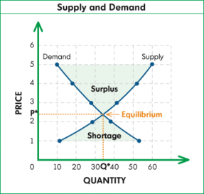
(IV) Equilibrium (Characteristics):
On the graph, equilibrium is the point at which the demand curve and the supply curve meet.

