Slide 1
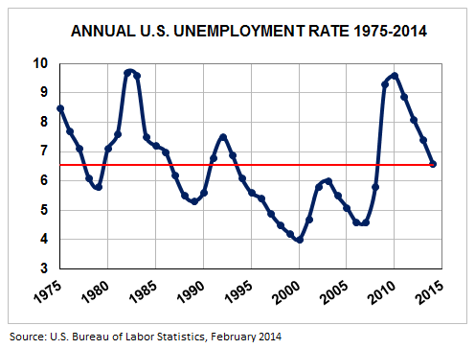
Measuring Unemployment

Slide 2
Unemployment Defined
Persons in the labor force who made an effort to look for work in the last month.

Slide 3
II. What is the labor force?
all people age 16 or older
those not in the military
people not in jail/prison
not living permanently in nursing homes or other institutions

Slide 4
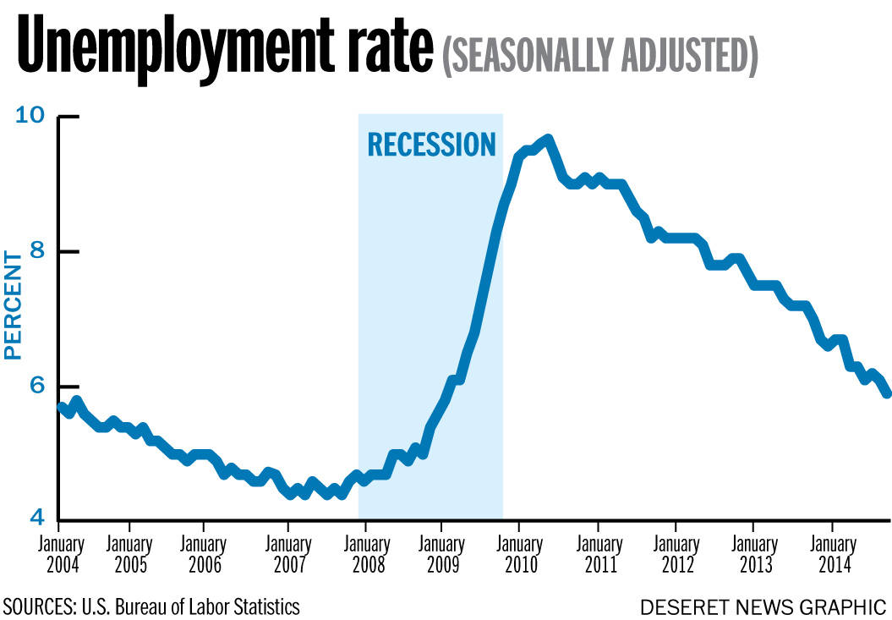
III. How to define the unemployment rate?
The number of unemployed individuals divided by the total number of people in the labor force.

Slide 5
IV. The unemployment rate is measured in three ways:
Household (contacting labor force) survey
Payroll (contacting businesses) survey
State unemployment claims

Slide 6
V. People who have a part-time job but want to work full-time are considered underemployed.

Slide 7
VI. Is full employment possible? Why or why not?

Slide 8
Types of Unemployment #1
I. Frictional:
1. Unemployment caused by a change in the workers’ circumstances - The situation is many times controlled by the individual
2. Typically a short-term situation
3. There is not normally economic hardships created from this situation

Slide 9
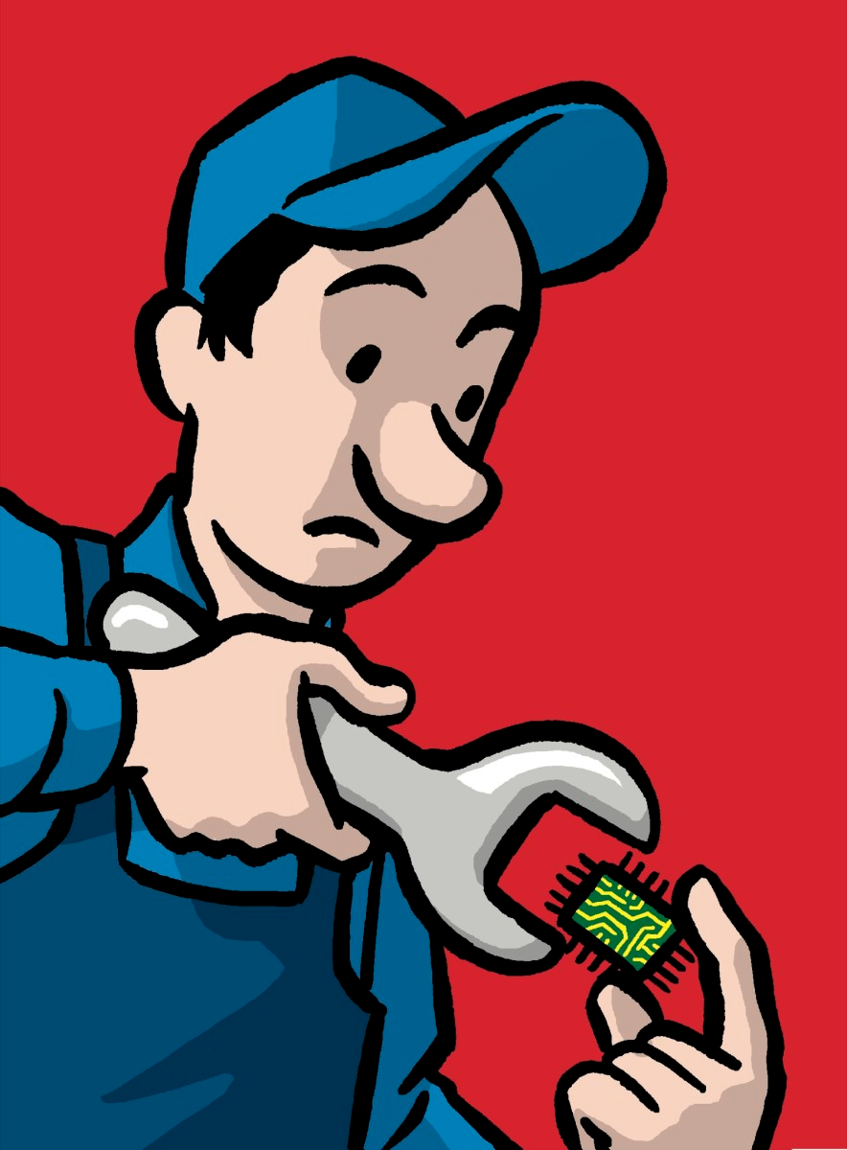
Types of Unemployment #2
II. Structural:
1. Unemployment caused by a fundamental change in the economy that demands a change in skills needed for a position
2. Often focuses on a particular industry and/or region of the country
3. The skill sets of the workers do not match the job
4. Education and training is needed for the unemployed to go back to work

Slide 10
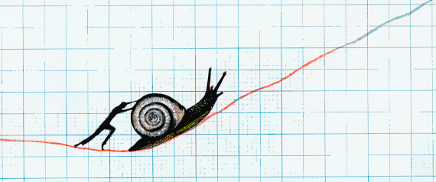
Types of Unemployment #3
III. Cyclical:
1. Unemployment is created by shifts in the business cycle which impacts the whole economy
2. When the economy slows, these jobs are lost, and unemployment is created
3. When the economy rebounds people typically go back to work

Slide 11
Types of Unemployment #4
IV. Seasonal:
1. This type of job loss is due to a decrease in demand because of a change in season
2. The jobs return when the season (time of year) returns

